Slide 1
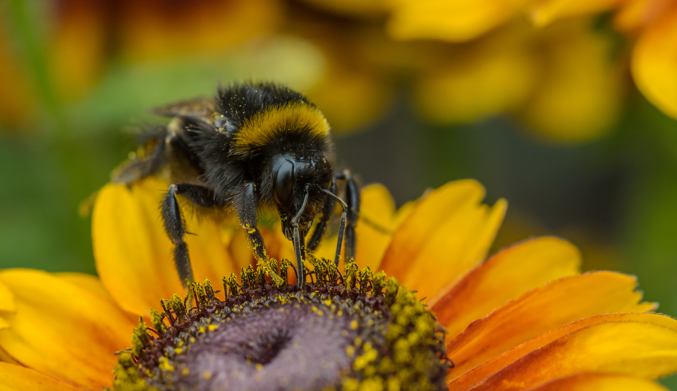
Effects of Pesticides on bees
Surabhi Nair
Question: How are bumblebee foraging patterns and preferences affected by prolonged exposure to pesticides?

Slide 2
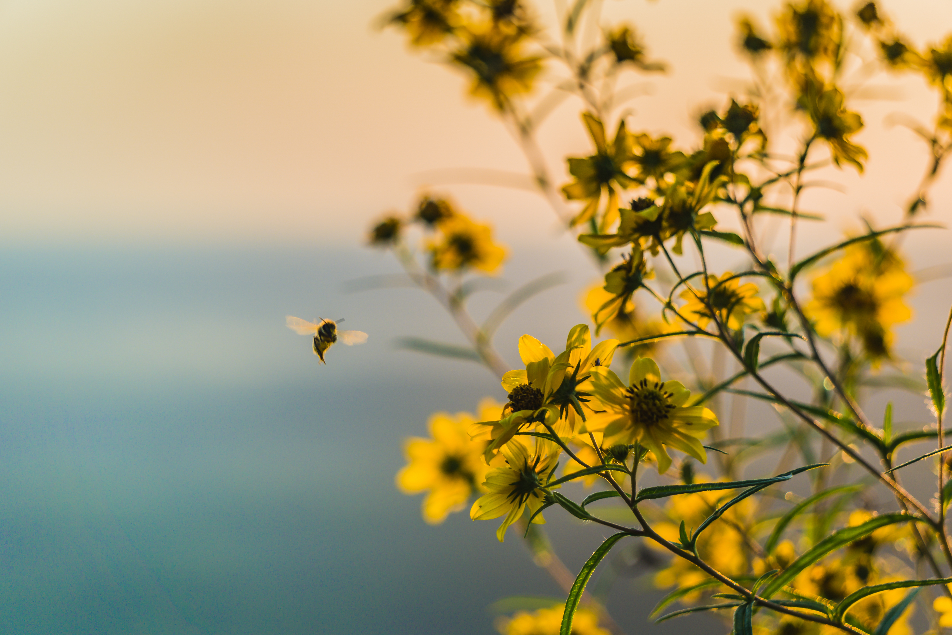
Motivation and Background
Bees are crucial to maintaining ecosystems, and bumblebees are excellent pollinators
Helps us understand the unintended consequences of using pesticides (particularly neonicotinoids)
Notes:
Bumblebees are responsible for pollination of sunflowers, cotton, pumpkins, watermelon, peppers, tomatoes, clover, apples, citrus fruits, peaches, lima beans, mustard, many berries and more. (https://www.nps.gov/articles/bumble-bee.htm)
Neonicotinoids are a class of pesticide that EPA is in review of until 2018

Slide 3
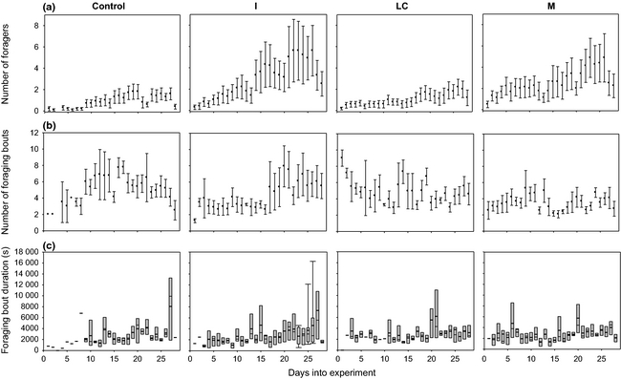
Approach
The data came from “Chronic impairment of bumblebee natural foraging behaviour induced by sublethal pesticide exposure” (2014)
The researchers observed the effects of two neonicotinoids (imidacloprid, λ-cyhalothrin), and their combined effect on foraging and pollen preferences of Bombus terrestris (buff-tailed bumblebee)
Using their data on pollen preferences, we can determine how bees pick flowers and how much pollen they carry, and how often they forage.
Notes:
The overall effect on foraging was that foraging efficiency decreased

Slide 4
The Data
There are two excel sheets
Foraging data – number of foraging bouts, duration of foraging sessions, days since beginning of experiment
Pollen Collection – amount of pollen collected & the type of pollen
Both contain the bee’s colony and treatment (what type/amount of pesticides were used)
One of the datasets has “AM” after duration, probably an error that interpreted duration as a timestamp, this can be fixed while parsing.
One uses dates, the other uses days since experiment began.

Slide 5
Anticipated Details
I will be repeating part of the original study
Determining how the treatments will affect the flower preference of the bees over time, and how much pollen bees carry, as well as a linear regression for foraging bouts.
Using a Poisson distribution model to model the amount of pollen foraged for each treatment over the duration of the 4 weeks
The researches used a Poisson distribution for the number of foraging bouts and foragers but not for pollen data.
Can be used to predict the amount of pollen foraged after a certain amount of exposure, can be done for each treatment.
Notes:
Focusing on pollen. Flower preference is indicated by the type of pollen that the bees brought in that were rated on a color scale to help identify them.
The original study repeat should be a linear regression for foraging and a simple bar chart / pie chart for flower preferences.

Slide 6
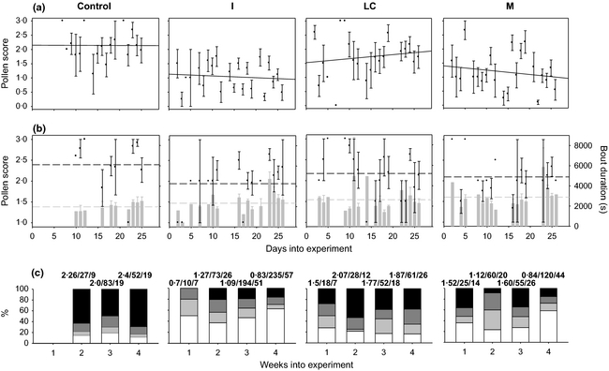
Anticipated Results
It is expected that bees treated with any type of pesticide will be less successful in the amount they forage and the amount of pollen they successfully forage
We can expect the Poisson distribution to take a similar shape for all the treatments, but the pesticide treatments will likely feature much lower probabilities for high pollen yields as time goes on.

Slide 7
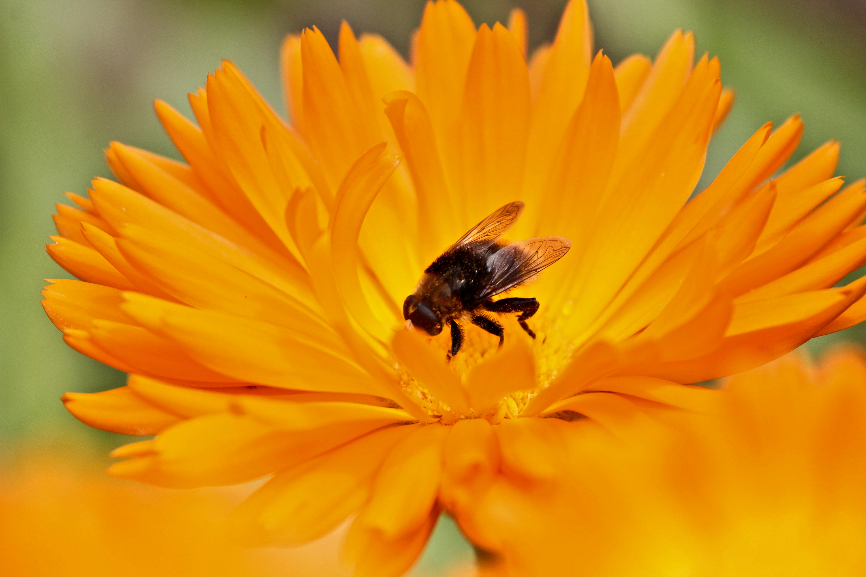
Sources:
Gill RJ, Raine NE (2014) Chronic impairment of bumblebee natural foraging behaviour induced by sublethal pesticide exposure. Functional Ecology 28(6): 1459-1471.
"Beekeepers and Public Interest Groups Sue EPA Over Bee-Toxic Pesticides." Pesticide Action Network.
"Pollinators." National Parks Service. U.S. Department of the Interior,

